Slide 1

Graph Embeddings
Node Classification & Link Prediction
Olha Baliasina, Samuel Chapuis
BDMA — Massive Graph Management and Analytics — CentraleSupélec
February 2026

Slide 2
What we set out to test
Does the embedding matter, or the predictor on top?
Same Node2Vec embedding: F1 = 0.59 with LogReg, 0.76 with RF. A 17-point gap from just swapping the classifier.
Do AUC and MRR agree on which method wins?
Node2Vec: AUC = 0.95 (best). Jaccard: MRR = 0.73 (best). Completely opposite rankings.
Do real node features change the picture?
VGAE on structural features: AUC = 0.78. On real artist preferences: AUC = 0.95. Same model, different input.
2 / 34

Slide 3
Datasets
CA-HepTH
LastFM
Academic co-authorship
Social music network
Nodes
10,397 authors
Nodes
7,624 users
Edges
22,243 co-authorships
Edges
27,806 mutual follows
Labels
7 ArXiv subfields (14% labeled)
Labels
18 countries (100% labeled)
Features
None — structural only
Features
7,842d artist preferences
Labels
Features
Real ArXiv cross-listing categories (e.g. "Mathematical Physics", "Quantum Algebra"). Each author assigned their most frequent secondary field.
Sparse binary vector: 7,842 artists, 1 if user listened to that artist, 0 otherwise. Avg ~395 active artists per user. Every user has a unique musical fingerprint.
Why chosen
Why chosen
Small enough to run all 10 methods. No node features → isolates embedding quality. Partial labels (14%) test realistic sparse-label regime.
Dataset with real node features. Lets us test: do GNNs and VGAE improve when they receive content information instead of generic structural features?
3 / 34

Slide 4
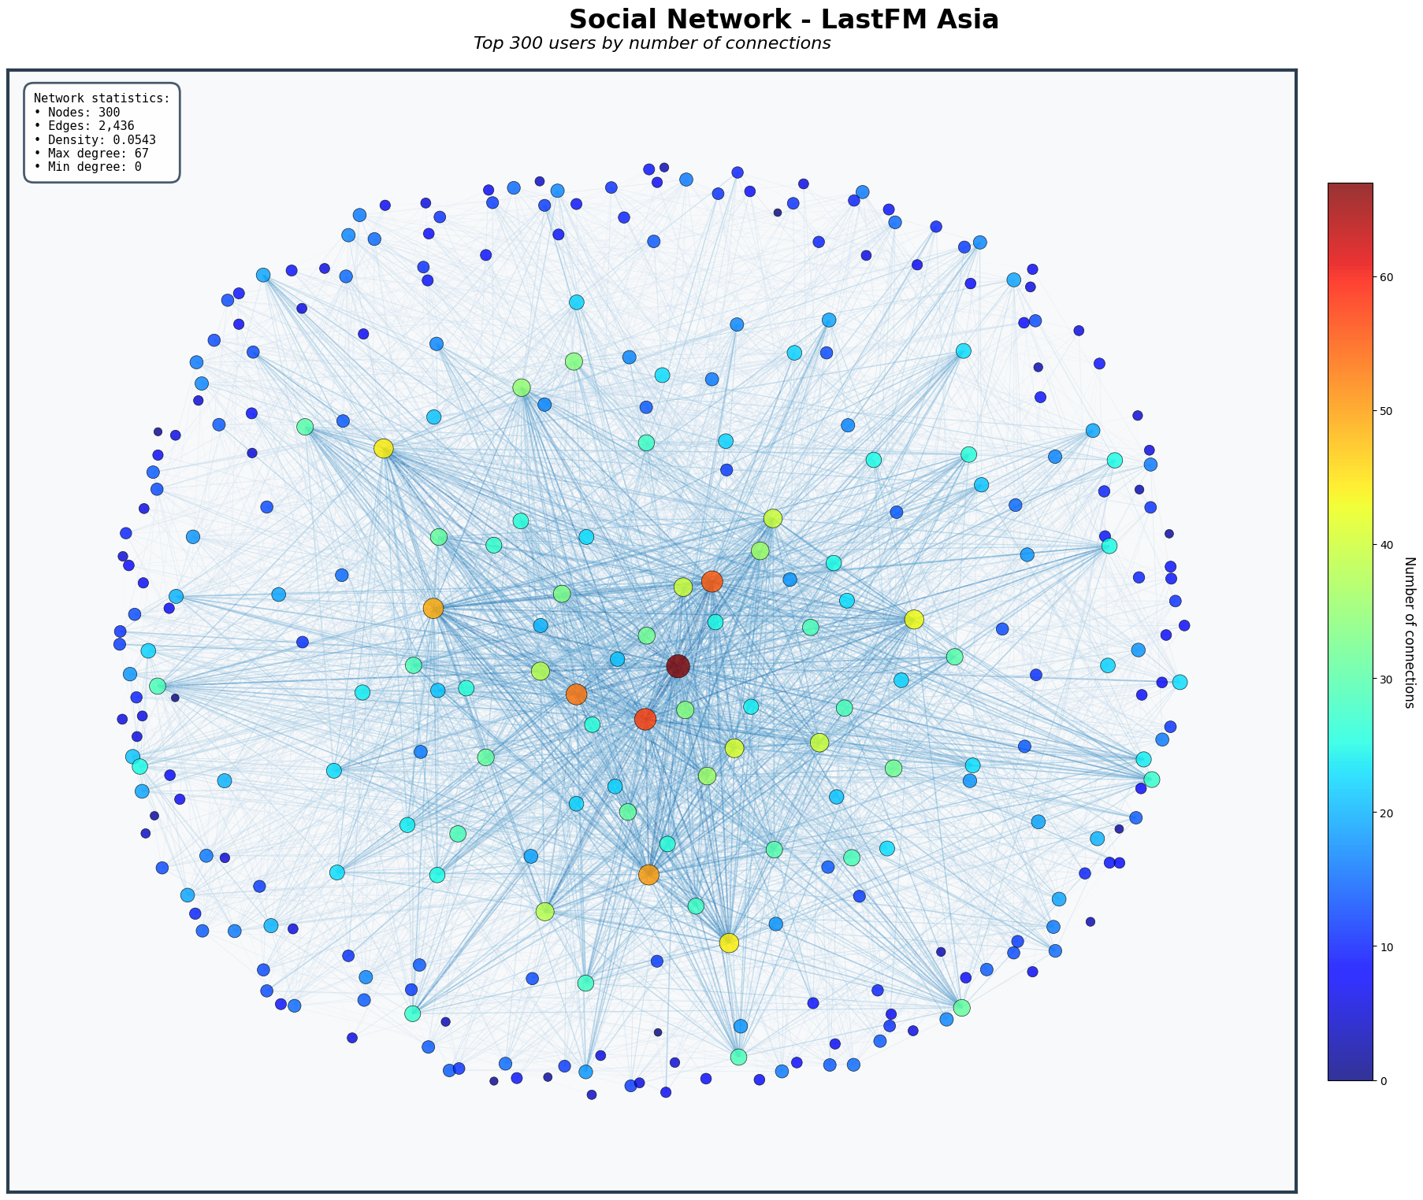
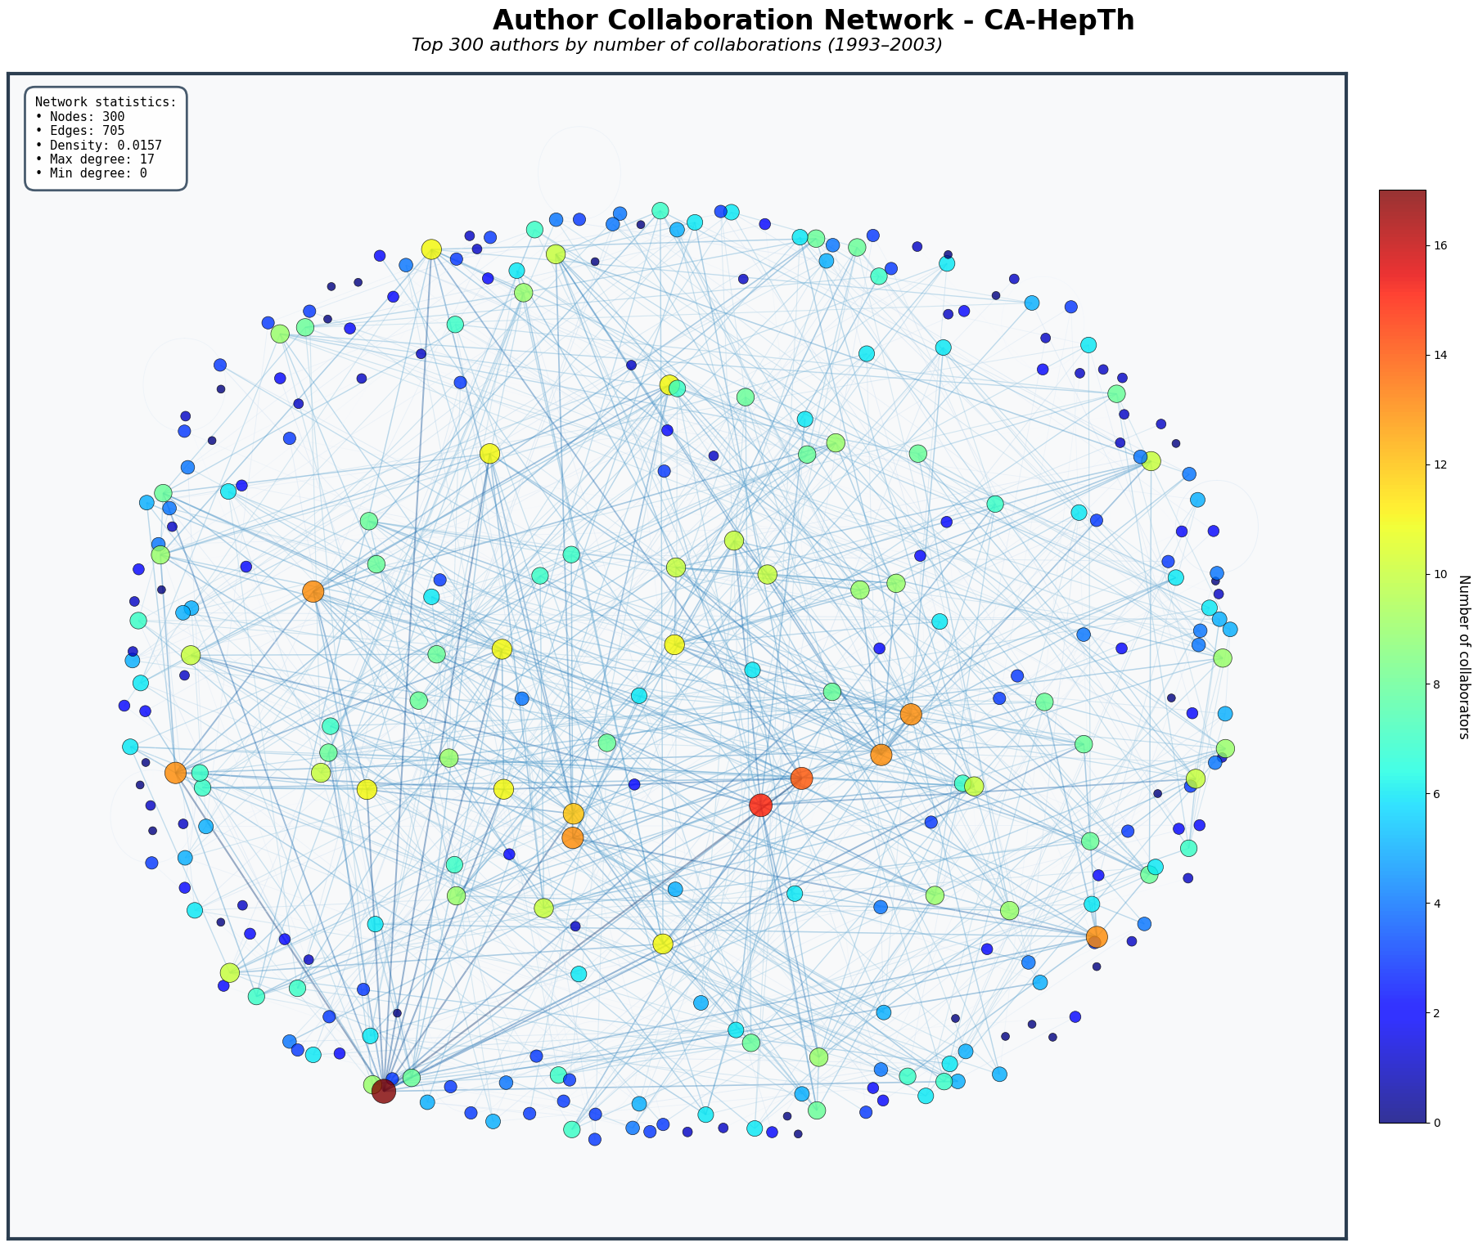
Datasets Visualization: Sample 300 Nodes
LastFM User Network
HepTh Co-Authorship
4 / 34

Slide 5
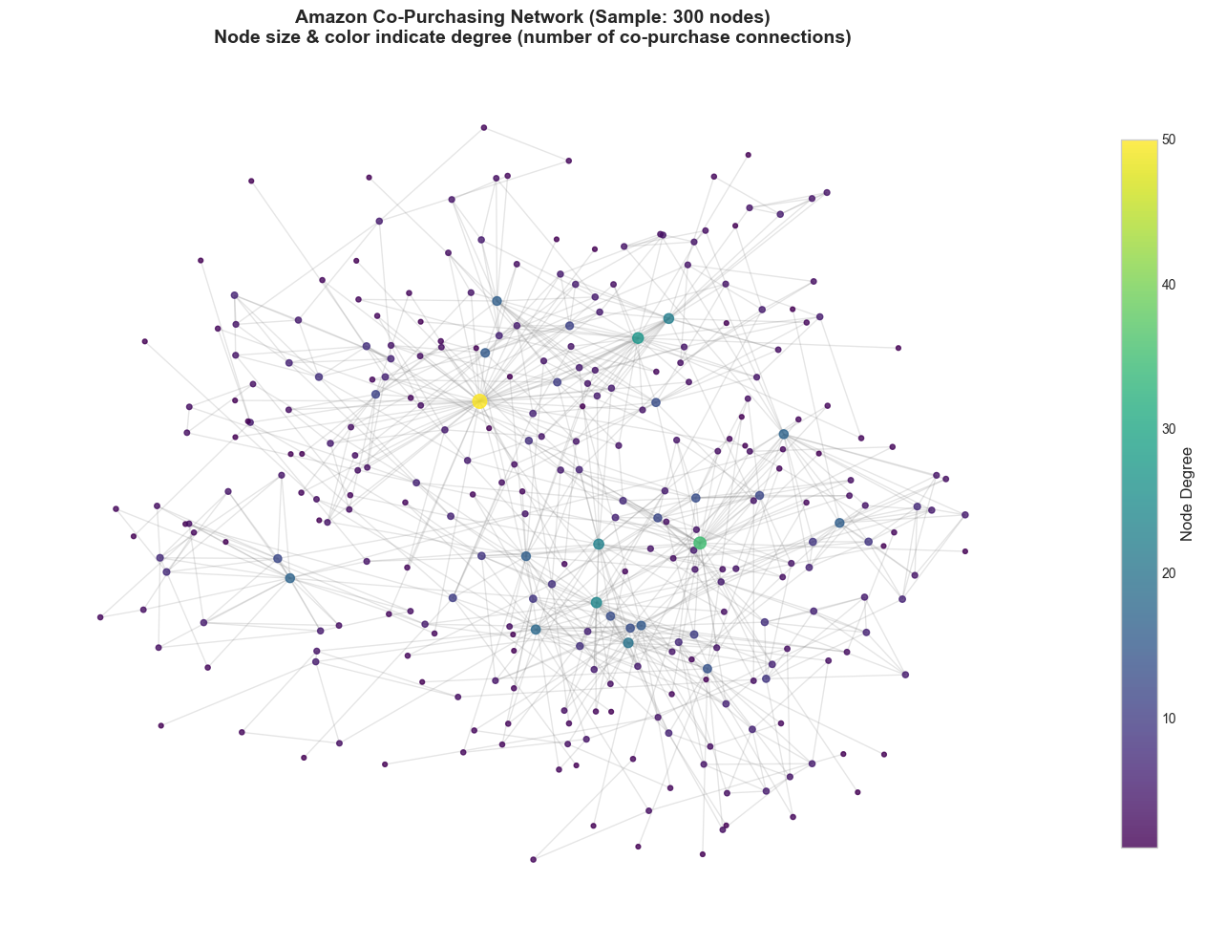
Datasets
Amazon Co-Purchase
334,863 nodes 925,872 edges
Labeling strategy: assign each node the community where it shares the most neighbors. Principled structural embedding — not random.
20 communities (≥1000 members each) • 173K labeled nodes • Overlapping categories resolved via structural support
Challenge: fuzzy boundaries between categories (e.g., Electronics vs Computers), hierarchical product taxonomy, power-law community sizes
5 / 34

Slide 6
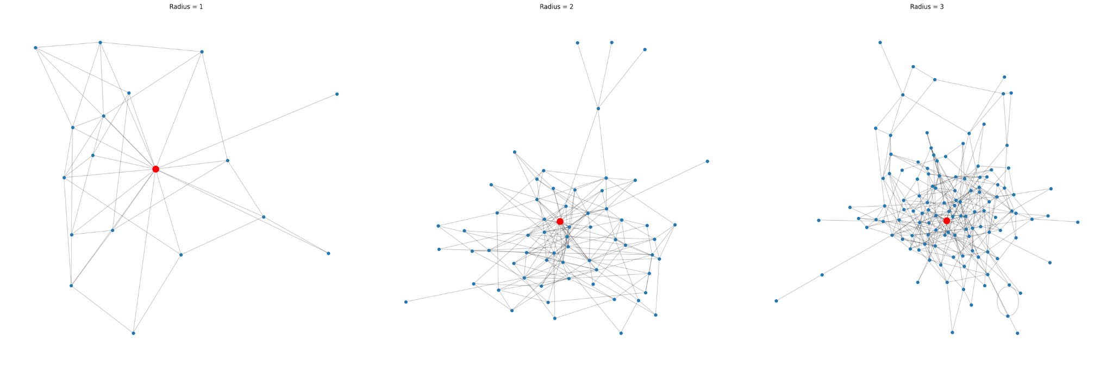
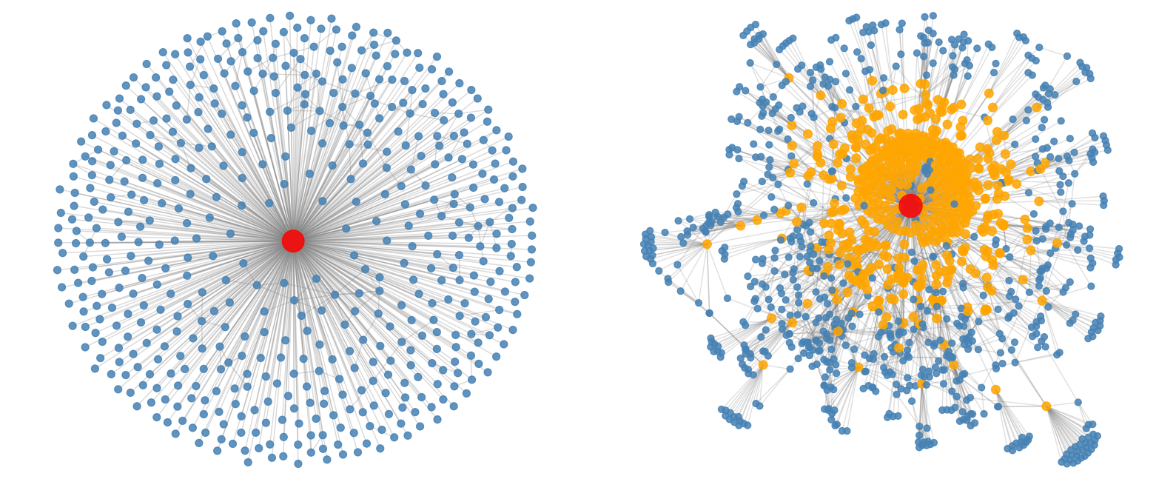
Datasets - Sample firsts hops
HepTh Co-Authorship
hop-1
hop-2
hop-3
Amazon Co-Purchase
hop-1
hop-2
3 / 18
6 / 34

Slide 7
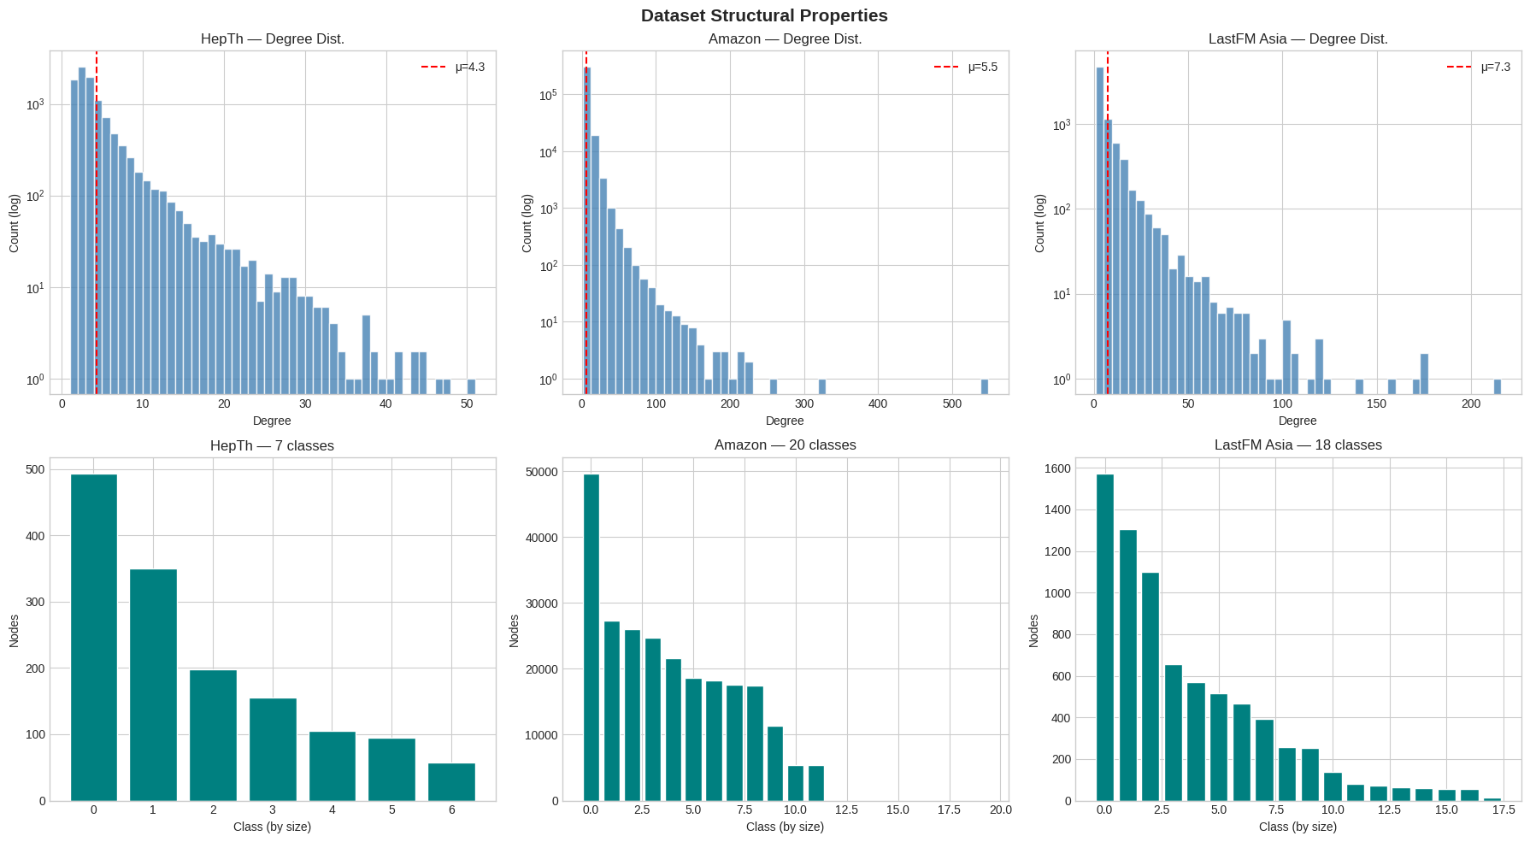
Datasets - Degree centrality distribution
7 / 34

Slide 8
Embedding methods + 4 baselines
Grouped by how they learn representations
Shallow
GNN-based
Knowledge Graph
Heuristic baselines
GraphSAGE
TransE
Common Neighbors
Mean aggregation, supervised, end-to-end
Translation: h + r ≈ t
count shared neighbors
DeepWalk
GAT
DistMult
Jaccard Coefficient
Random walks → Word2Vec Skip-Gram
Attention aggregation, 4 heads
Bilinear: hᵀ diag(r) t
CN / union of neighborhoods
Node2Vec (q=0.5)
Adamic-Adar
Biased walks (DFS/BFS) → Word2Vec
weight rare shared neighbors higher
GRU-Walk
Preferential Attach.
Walks → GRU encoder (sequential)
Self-supervised GNN
Generative
deg(u) × deg(v)
Spectral
Laplacian eigenvectors (no training)
DGI
VGAE
Contrastive: real graph vs corrupted
VAE reconstructing adjacency σ(ZZᵀ)
KEY INSIGHT
Each family learns a different objective. Walk methods optimize co-occurrence. GNNs optimize labels. KGE methods optimize edge reconstruction.
This diversity is the experiment: does the objective determine what the embedding captures?
8 / 34

Slide 9
Node classification pipeline
Path A: Unsupervised
Graph
(adjacency)
Embedding
method
128d vectors
LogReg
or RF
F1
macro
❄ FROZEN
DeepWalk
Node2Vec
Spectral
GRU-Walk
FINDING 1
random walks → Word2Vec
biased walks → Word2Vec
Laplacian eigenvectors
walks → GRU contrastive
Same embedding, different classifier:
Node2Vec + LogReg = 0.59
Node2Vec + RF = 0.76
Δ = +17 points
TransE
DistMult
DGI
h + r ≈ t
bilinear hᵀ diag(r) t
contrastive GNN
Path B: Supervised end-to-end (GraphSAGE, GAT)
Graph +
Features
GNN
encoder
Embedding
Softmax
classifier
F1
macro
⇄ JOINT TRAINING
←←← gradients flow back through entire model ←←←
Key difference: Path A freezes embeddings, then trains a separate classifier. Path B trains embedding + classifier together. This is why GraphSAGE can reshape the embedding to fit class boundaries.
9 / 34

Slide 10
Node classification results (F1-macro)
Path A: Unsupervised
Path B: Supervised
Method | HepTh LogReg | HepTh RF | LastFM LogReg | LastFM RF
DeepWalk | 0.55 | 0.70 | 0.78 | 0.76
Node2Vec (q=0.5) | 0.59 | 0.76 | 0.77 | 0.75
Spectral | 0.07 | 0.61 | 0.02 | 0.65
GRU-Walk | 0.46 | 0.37 | 0.75 | 0.65
TransE | 0.41 | 0.47 | 0.67 | 0.60
DistMult | 0.26 | 0.24 | 0.65 | 0.64
DGI | 0.58 | 0.66 | 0.53 | 0.58
HepTh | LastFM
GraphSAGE | 0.72 | 0.80
GAT | 0.69 | 0.79
Best unsupervised: Node2Vec + RF (0.76 on HepTh, 0.78 DeepWalk LogReg on LastFM). GraphSAGE wins LastFM (0.80) but loses to Node2Vec+RF on HepTh (0.72 vs 0.76).
Green = best. Red = near failure. Amazon NC omitted for readability (DeepWalk RF 0.84, Node2Vec RF 0.85, GraphSAGE 0.86).
10 / 34

Slide 11
FINDING 1
The predictor matters as much as the embedding
+17
+15
−2
HepTh Node2Vec
LogReg 0.59 → RF 0.76
Amazon DeepWalk
LogReg 0.66 → RF 0.84
LastFM DeepWalk
LogReg 0.78 → RF 0.76
Walk-based embeddings optimize for graph proximity, not class separation. Class boundaries in embedding space are nonlinear. RF carves irregular decision regions; LogReg can only draw straight hyperplanes.
On LastFM the gap reverses: the social graph has strong country-level homophily, so DeepWalk walks already separate countries in a roughly linear way. RF slightly overfits on 18 classes.
11 / 34

Slide 12
Link prediction pipeline
Full graph
(all edges)
Edge split
90% train edges
10% test edges
+ negative samples
Shallow Embedding methods
Train graph
(90% edges)
Learn embed.
on train graph
dot(u, v)
score
Evaluate on
test edges
AUC
KGE methods (TransE, DistMult)
Binary: real vs fake edge
Train triples
(h, r, t)
Optimize
h+r≈t / bilinear
Native scoring
(built-in)
score
MRR
Ranking: where is correct?
Heuristic baselines (no training)
Hits@10
Train graph
structure
No training
no embedding
Jaccard / AA
CN / PA
score
Top-10 inclusion rate
FINDING 2: AUC and MRR pick different winners on every dataset.
12 / 34

Slide 13
Link prediction results
 | HepTh AUC | HepTh MRR | HepTh Hits@10 | Amazon AUC | Amazon MRR | Amazon Hits@10 | LastFM AUC | LastFM MRR | LastFM Hits@10
DeepWalk | .846 | .481 | .6725 | .951 | .222 | .7612 | .865 | .091 | .1880
Node2Vec | .844 | .392 | .6478 | .953 | .241 | .7459 | .862 | .094 | .1660
TransE | .913 | .344 | .7152 | — | — | — | — | — | —
GraphSAGE-LP | .8164 | .0783 | .2560 | — | — | — | . 8106 | . 0325 | .0745
VGAE | .778 | .059 | .1600 | .860 | .014 | .0335 | .954 | .207 | .3180
Adamic-Adar | .874 | .657 | .7481 | .869 | .713 | .7372 | .844 | .234 | .4720
Jaccard | .874 | .510 | .7481 | .869 | .725 | .7372 | .843 | .135 | .4075
Pattern: embeddings win AUC, heuristics win MRR on every dataset. Exception: VGAE on LastFM (real features) wins AUC.
AUC
MRR
Can you separate real edges from fake?
Embeddings: smooth continuous scores across all pairs. Good for binary yes/no.
Does the correct edge rank first?
Heuristics: most pairs score 0, correct edges get high scores. Decisive for ranking.
13 / 34

Slide 14
FINDING 2
AUC and MRR disagree on every dataset
Best by AUC
Best by MRR
HepTh: TransE (0.913)
Amazon: Node2Vec (0.953)
LastFM: VGAE (0.954)
VS
HepTh: Adamic-Adar (0.657)
Amazon: Jaccard (0.725)
LastFM: Adamic-Adar (0.234)
Three datasets, complete disagreement. Heuristics dominate ranking despite zero training. Any LP evaluation reporting only AUC is incomplete.
This is why we include heuristic baselines: they expose a systematic weakness of learned embeddings that AUC alone would hide.
14 / 34

Slide 15
FINDING 3
Real features transform models that can see them
VGAE with structural features
VGAE with real features
AUC 0.78
AUC 0.95
HepTh: 4d input (degree, clustering, PR, core)
LastFM: 7842d artist preferences
Same architecture design, same training procedure. The only difference is what the encoder receives as input. With 4 generic structural features, many nodes look identical. With 7842 real preferences, every user is distinguishable.
Only models that receive features benefit: VGAE and GNNs (GraphSAGE 0.72 → 0.80). Walk methods (DeepWalk, Node2Vec, etc.) never see features, so their performance difference across datasets reflects graph topology, not features.
15 / 34

Slide 16
FINDING 4
Training objective limits what embeddings capture
The objective matters
TransE gets 0.41 on NC but leads LP with AUC = 0.91. It's not a bad embedding. It optimizes for h+r≈t (edge reconstruction), which captures connectivity, not class membership.
DistMult (bilinear) is even worse: 0.26/0.24. Extra flexibility without signal.
GRU-Walk: 0.46/0.37 on HepTh (contrastive loss hard to optimize) but 0.75 on LastFM.
16 / 34

Slide 17
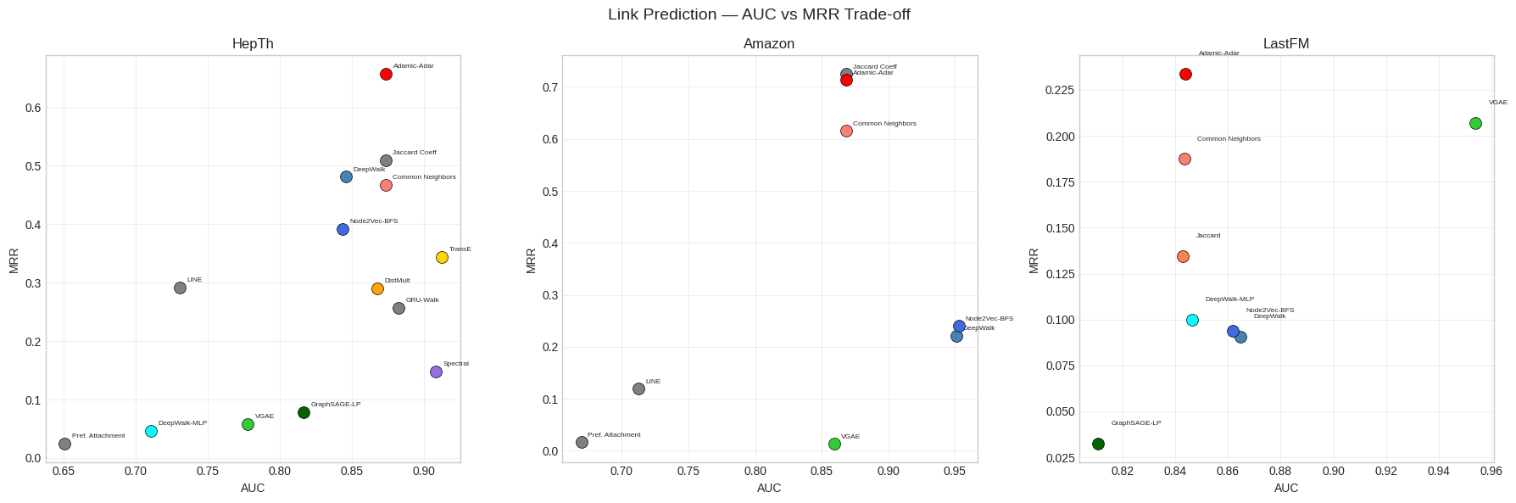
AUC - MRR Map
i
17 / 34

Slide 18
What we would recommend in practice
Graph without features
F1 = 0.76 (HepTh), 0.85 (Amazon). Beats GraphSAGE on HepTh. Unsupervised, fast, strong.
Node2Vec + Random Forest
Graph with real features
F1 = 0.80 (LastFM). Feature information gives supervised GNNs a clear advantage over walk methods.
GraphSAGE
Link prediction
Adamic-Adar / Jaccard dominate MRR on all datasets. Zero training cost. Exposes ranking weakness of embeddings.
Always include heuristic baselines
Reporting LP results
They disagree on 3/3 datasets. Single metric gives an incomplete picture of method quality.
Report both AUC and MRR
18 / 34

Slide 19
Appendix
Method explanations, scoring functions, and classifier details

Slide 20
APPENDIX
DeepWalk
Unsupervised / Random Walk
How it works
Generate random walks (length 40, 10 per node). Treat walks as sentences, node IDs as words. Train Word2Vec Skip-Gram: for each node in a walk, predict the 5 nodes on either side. The Skip-Gram weight matrix becomes the 128d embedding. Nodes that co-occur in walks get similar vectors.
Why it works
Where it fails
Random walks naturally stay within densely connected regions. Nodes in the same community co-occur frequently, so they get similar embeddings. Works across all graph types without tuning.
Continuous embedding scores create many near-ties for LP ranking (MRR = 0.22 on Amazon despite AUC = 0.95). Optimizes for proximity, not class separation, so NC needs a nonlinear classifier (RF) to work well.
Our results
NC: HepTh RF 0.70, Amazon RF 0.84, LastFM LogReg 0.78. LP: Amazon AUC 0.95 (best), MRR 0.22 (poor). Reliable baseline everywhere. walk_length=40 covers 2–3 community diameters, window=5 captures ~2-hop context.

Slide 21
APPENDIX
Node2Vec (q=0.5)
Unsupervised / Biased Walk
How it works
Same pipeline as DeepWalk (walks → Skip-Gram) but walks are biased. From node v (coming from t), the next step x gets weight: 1/p if backtracking to t, weight 1 if x is neighbor of t (local), weight 1/q if x is NOT neighbor of t (explore). With q=0.5: 1/q = 2, so exploring outward is twice as likely. This is DFS-like, not BFS.
Why it works
Where it fails
DFS-like walks explore broader context. For HepTh, where subfields span multiple local clusters, this captures cross-community structure. Slight improvement over DeepWalk (HepTh NC RF: 0.76 vs 0.70).
Same LP ranking problem as DeepWalk (continuous scores, many ties). The improvement over DeepWalk is only 1–3 points because the graphs have clear enough structure that even unbiased walks find it.
Our results
NC: HepTh RF 0.76 (+6 over DW), Amazon RF 0.85, LastFM LogReg 0.77. LP: Amazon AUC 0.95, HepTh AUC 0.84. Small but consistent improvement over DeepWalk. The small gap means walk bias helps but isn't critical for these graphs.

Slide 22
APPENDIX
Spectral Embedding
Algebraic / No training
How it works
Compute graph Laplacian L = D − A. Find the 128 smallest eigenvectors of L. Each node's embedding = its values across these 128 eigenvectors. No optimization, no parameters, pure linear algebra. The smallest eigenvectors minimize graph cuts — nodes in dense regions get similar coordinates.
Why it works
Where it fails
Captures global connectivity structure. Connected nodes live in dense spectral regions and get similar coordinates. Excellent for binary edge classification. HepTh LP AUC = 0.91.
NC LogReg: 0.07 (HepTh), 0.02 (LastFM). Near random. Eigenvectors capture density, not class labels. Two same-class nodes in different graph regions get very different spectral coordinates. Also: doesn't scale. Infeasible on Amazon (335K nodes).
Our results
LP AUC: 0.91 on HepTh (great). NC LogReg: 0.07 on HepTh (disaster). RF rescues NC to 0.61 by learning nonlinear combinations. Strongest evidence that embedding quality is task-dependent: same embedding, 0.91 on LP, 0.07 on NC.

Slide 23
APPENDIX
DGI (Deep Graph Infomax)
Self-supervised GNN
How it works
Run a GCN on the real graph → get node embeddings. Corrupt the graph (shuffle features) → run same GCN → get fake embeddings. Compute graph summary s = sigmoid(mean of all embeddings). Train discriminator: real node embeddings scored against s should be high, fake should be low. BCE loss. No labels used.
Why it works
Where it fails
Uses GNN architecture (aggregates neighbors) without needing labels. Contrastive objective implicitly captures what makes the real graph structure informative. HepTh NC: 0.58/0.66, competitive with DeepWalk.
LastFM NC: 0.53/0.58, below DeepWalk's 0.78. The corruption (shuffling features) is too easy to detect when features already cluster by country. DGI learns a shallow "do features match neighborhood?" signal instead of deep structural representation.
Our results
HepTh NC: LogReg 0.58, RF 0.66 (no labels needed, within range of walk methods). LastFM NC: LogReg 0.53, RF 0.58 (underperforms — contrastive objective doesn't align with country labels). Bridge between unsupervised walks and supervised GNNs.

Slide 24
APPENDIX
GRU-Walk
Unsupervised / RNN encoder
How it works
Same random walks as DeepWalk. But instead of Skip-Gram (bag of center-context pairs), feed the walk sequence into a GRU. The GRU processes node IDs left-to-right, maintaining a hidden state. Train with contrastive loss: pairs from same walk should be similar, random pairs dissimilar. Embedding = learned lookup table entries.
Why it works
Where it fails
GRU can capture sequential dependencies Skip-Gram misses (e.g. "after visiting a hub, walks go to periphery"). HepTh LP Hits@10 = 0.74, competitive with heuristics. Connects to RNNLogic from semester 1.
Doesn't consistently beat DeepWalk. LastFM NC LogReg: 0.75 vs DW 0.78. Skip-Gram is a very strong optimized baseline. Sequential information in undirected graph walks may not carry enough additional signal to justify the heavier model.
Our results
LastFM NC: LogReg 0.75, RF 0.65. HepTh LP: AUC 0.88, Hits@10 0.74. Inconsistent improvement over DeepWalk. The extra modeling capacity of GRU doesn't reliably pay off on these graphs.

Slide 25
APPENDIX
TransE
Knowledge Graph Embedding
How it works
Every entity gets vector h or t, every relation gets vector r. Score(h,r,t) = −||h + r − t||. Training: for each real triple, sample a corrupted triple (replace head or tail). Margin loss pushes real scores above corrupted scores. Geometric meaning: relation r is a translation vector; h + r should land near t.
Why it works
Where it fails
Translation prior is a strong global regularizer. All co-author pairs must be offset by roughly the same vector r. Forces globally consistent embedding. HepTh LP AUC = 0.91 (best of all methods). On single-relation graphs, r acts like a global bias.
NC: HepTh LogReg 0.41, RF 0.47. Translation objective encodes connectivity, not class membership. Two same-class authors can have very different positions if they collaborate with different people. Training objective constrains what the embedding captures (Finding 4).
Our results
LP: HepTh AUC 0.91 (best), LastFM AUC n/a. NC: HepTh 0.41/0.47 (poor). The same embedding that leads LP is near-worst for NC. We skip TransH/TransR because their innovations (per-relation hyperplanes/projections) need multiple relation types to be useful.

Slide 26
APPENDIX
DistMult
Knowledge Graph Embedding
How it works
Entities get vectors h, t. Relation gets vector r. Score(h,r,t) = Σ_i (h_i × r_i × t_i) = hᵀ diag(r) t. Bilinear scoring: r acts as a diagonal weight matrix. Naturally symmetric (score(h,r,t) = score(t,r,h)), which should suit undirected co-authorship. Same margin-based training as TransE.
Why it works
Where it fails
Symmetric scoring fits symmetric relations (co-authorship). Bilinear form allows each embedding dimension to be weighted differently by the relation. Should theoretically suit single undirected relation.
HepTh LP AUC: 0.87, below TransE's 0.91. Extra bilinear flexibility adds parameters without useful signal on single-relation graph. NC: LogReg 0.26, RF 0.24 — worst NC of any method. Bilinear objective is even less aligned with class structure than translation.
Our results
LP: HepTh AUC 0.87. NC: HepTh 0.26/0.24 (worst). Despite symmetric scoring matching symmetric co-authorship, TransE's rigid translation constraint provides better regularization. DistMult shines on multi-relational KGs, not here.

Slide 27
VGAE — Variational Graph Auto-Encoder
Kipf & Welling, 2016 (arXiv:1611.07308)
Generative / Autoencoder
Architecture
Input
A + X
GCN Encoder
Sample z
Decoder
Â
reconstructed
adjacency
Layer 1: shared
GCN(A, X) → H
z = μ + σ ⊙ ε
ε ~ N(0, I)
Â = σ(Z Zᵀ)
Layer 2a: GCN → μ
Layer 2b: GCN → log σ²
reparametrization
trick
inner product
of latent vectors
adjacency
+ features
Loss function
Why it matters for our project
L = BCE(A, Â) + KL[ q(Z|X,A) || p(Z) ]
LP is the training objective itself
— not a downstream task, like in other cases. The decoder is dot(z_u, z_v).
The encoder reads node features as input
— VGAE is one of the methods that sees features.
Reconstruction: did we predict the correct edges?
Regularizer:
keep latent space smooth (close to N(0,I))
Our results: same model, different input
HepTh — 4d structural features
→
LastFM — 7,842d artist preferences
Same architecture, same training.
4d → many nodes look identical.
7842d → every user is distinguishable.
AUC = 0.78
degree, clustering
coeff, PageRank, core
AUC = 0.95
sparse binary:
which artists
each user likes

Slide 28
APPENDIX
GraphSAGE
Supervised GNN
How it works
For each node: sample neighbors, compute MEAN of their features, concatenate with own features, apply linear + ReLU. Repeat for 2 layers. Final: linear → softmax → class probabilities. Train end-to-end with cross-entropy on labeled nodes. "SAGE" = Sample and Aggregate.
Why it works
Where it fails
Only method that optimizes directly for class prediction. Embedding and classifier trained jointly, so the embedding learns to separate classes. Mean aggregation is simple but robust. Scalable via neighbor sampling. Best NC on all 3 datasets.
For LP (used as encoder + decoder): HepTh AUC 0.82, LastFM 0.81. Decent but not best — wasn't designed for LP. The NC-optimized embedding doesn't necessarily encode edge likelihood.
Our results
NC: HepTh 0.72, Amazon 0.86, LastFM 0.80 (best everywhere). LP: HepTh 0.82, LastFM 0.81. GraphSAGE > GAT consistently because mean aggregation works when all neighbors are roughly equally informative.

Slide 29
APPENDIX
GAT (Graph Attention)
Supervised GNN
How it works
Like GraphSAGE but with learned attention weights. For node i and neighbor j: e_ij = LeakyReLU(aᵀ[Wh_i || Wh_j]). Normalize: α_ij = softmax(e_ij). Aggregate: h_i' = Σ_j α_ij Wh_j. Multi-head: 4 independent attention heads, concatenate results. More parameters than SAGE.
Why it works
Where it fails
In theory: some neighbors are more informative than others. A prolific co-author (degree 200) is less informative about your subfield than a close collaborator (degree 5). Attention can learn to down-weight hubs.
In practice: underperforms GraphSAGE on all 3 datasets. HepTh 0.67 vs 0.72, Amazon 0.80 vs 0.86. 4-head attention quadruples aggregation parameters. With only 14% labeled nodes (HepTh), not enough supervision to learn good weights.
Our results
NC: HepTh 0.67, Amazon 0.80, LastFM 0.79. Consistently behind GraphSAGE. Would likely win on heterogeneous graphs where neighbor roles differ substantially, or with much more labeled data.

Slide 30
APPENDIX
Heuristic Scoring Functions (LP only)
Not embedding methods. No parameters, no training. Compute a score per node pair directly from graph structure. Comparable to embeddings because LP evaluation is at the output level: every method produces one score per pair.
Common Neighbors
CN(u,v) = |N(u) ∩ N(v)|
AUC ~0.87. Decent classification, mediocre ranking (many ties).
Count shared neighbors. Simple counting baseline.
Jaccard Coefficient
J(u,v) = |N(u) ∩ N(v)| / |N(u) ∪ N(v)|
Best MRR on Amazon (0.73). Co-purchase is about proportional overlap.
Normalize CN by total neighborhood. Proportional overlap. Two niche products sharing 5/8 neighbors (0.63) > two popular ones sharing 5/50 (0.10).
Adamic-Adar
AA(u,v) = Σ 1/log(deg(w)) for shared w
Best MRR on HepTh (0.66) and LastFM (0.23). Hub penalty suits co-authorship triadic closure.
Weight rare shared neighbors higher. Shared collaborator with degree 3 contributes 0.91; hub with degree 1000 contributes 0.14. Hub penalty.
Preferential Attachment
PA(u,v) = deg(u) × deg(v)
MRR ~0.02 everywhere. Catastrophic. Hubs are already connected; new edges form between medium-degree nodes.
Predict edges between hubs. Product of degrees.

Slide 31
APPENDIX
Classifiers (NC) & Decoders (LP)
Standard ML components that sit on top of embeddings.
The choice of classifier/decoder matters as much as the embedding itself (Finding 1).
Node Classification
Link Prediction
Logistic Regression
Linear hyperplane in embedding space. argmax_k(w_k · emb + b_k). Fails when class boundaries are curved.
Random Forest
Ensemble of decision trees. Axis-aligned splits carve irregular regions. Handles nonlinear boundaries. Beats LogReg by 10–18 pts on walk embeddings.
Dot Product
score = u · v. Assumes edges = high similarity in embedding space. Linear. Fast.
MLP Decoder
score = MLP(concat(u, v)). Learns nonlinear function of both embeddings. Helps when edge formation depends on complex feature interactions.
Why RF beats LogReg (and when it doesn't)
Walk-based embeddings optimize for graph proximity: nearby nodes in walks → nearby vectors. Class boundaries in this space are nonlinear because classes don't form convex clusters. LogReg draws flat hyperplanes and misses the curved boundaries. RF's decision trees carve around these irregularities.
Exception: LastFM DeepWalk LogReg 0.78 > RF 0.76. The boundaries happen to be roughly linear in this case because the social clusters by country are relatively well-separated (not interleaved like research subfields on HepTh).

Slide 32
APPENDIX
Hyperparameters & Design Choices
Parameter | Value | Justification
Embedding dim | 128 | Standard across DeepWalk, Node2Vec, DGI papers. Fixed for fair comparison.
Walk length | 40 | Covers 2–3 community diameters (graphs have diameter ~10–20). DeepWalk paper default.
Walks per node | 10 | Standard coverage/speed tradeoff. More walks = better estimates but slower.
Skip-Gram window | 5 | Captures ~2-hop structure. Standard Word2Vec setting.
Node2Vec q | 0.5 | DFS-like (1/q=2, explores outward). Captures broader cross-community context.
GNN layers | 2 | 2-hop aggregation. 3+ layers cause oversmoothing on small graphs.
GNN hidden dim | 128 | Matches embedding dim for fair comparison.
Dropout | 0.5 | Standard regularization for GNNs. Prevents overfitting on sparse labels.
KGE epochs | 200 | Convergence observed by ~150 epochs on all models.
LP test edges | 10% | Standard split. Embeddings retrained on training graph to avoid leakage.
NC split | 60/20/20 | Stratified train/val/test. Class-weighted loss for imbalance.
Ranking samples | ≤2000 | SE on MRR < 0.01 at 2000 samples. Sufficient for method comparison.

Slide 33
Thank You

